Slide 1



Manpower & Compliance Support Models
Persona-Based Overview of Services for Local and Foreign Staff

Slide 2

EXECUTIVE SUMMARY – WORKFORCE SOLUTIONS
Who We Are
Dawaam is a Libya-based manpower and compliance partner providing end-to-end staffing services tailored for the oil, gas, infrastructure, and industrial sectors.
What This Presentation Covers
This deck introduces four typical contractor types used in Libya — local, foreign (long-term), foreign short-term, and direct hire — and outlines how Dawaam supports each with fully compliant and operationally efficient workforce solutions.
What We Deliver
✔ Visa, residency & desert pass handling ✔ Payroll, tax & social security compliance ✔ Accommodation, transport & onboarding ✔ Active employer liability insurance ✔ Flexible pricing models to suit project needs
Why It Matters
Our service allows clients to reduce administrative burden, ensure legal compliance, and deploy workforce resources faster and with lower risk — all through a single local partner.

Slide 3



SHORT-TERM / LONG-TERM LOCAL CONTRACTORS
Persona Snapshot
Name
Fathi al-Misrati
Nationality
Libyan
Role Type
Local Contractor (on Dawaam payroll)
Typical Role
HSE Officer
Assignment Duration
Project-based (6–12 months)
Managed by
Dawaam
Operational Value Delivered by Dawaam
Fully compliant monthly payroll management
Local tax, social security, and legal contributions handled
Digital timesheet & invoice processing
Employment contract issuance & HR file maintenance
Covered under Dawaam’s active liability & employer insurance

Slide 4

SHORT-TERM FOREIGN CONTRACTOR
Persona Snapshot
Name
Kwame Mensah
Nationality
Ghanaian
Role Type
Short-Term Foreign Contractor
Typical Role
Instrumentation Technician
Assignment Duration
90 days
Managed by
Dawaam
Operational Value Delivered by Dawaam
Visa & Desert Pass Processing
Full logistical support (airport, hotel, transport)
On-time payroll & tax handling
Onboarding & contractor support during assignment
Covered under Dawaam’s active liability & employer insurance

Slide 5

LONG-TERM FOREIGN CONTRACTOR
Persona Snapshot
Name
Nabil Benyamina
Nationality
Algerian
Role Type
Long-Term Foreign Contractor
Typical Role
Senior Drilling & Mud Engineer
Assignment Duration
12+ months
Managed by
Dawaam
Operational Value Delivered by Dawaam
Visa & Residency Permit Processing
Desert Pass
On-time payroll & tax/social security compliance
Administrative support (flights, accommodation, documentation)
Covered under Dawaam’s active liability & employer insurance

Slide 6
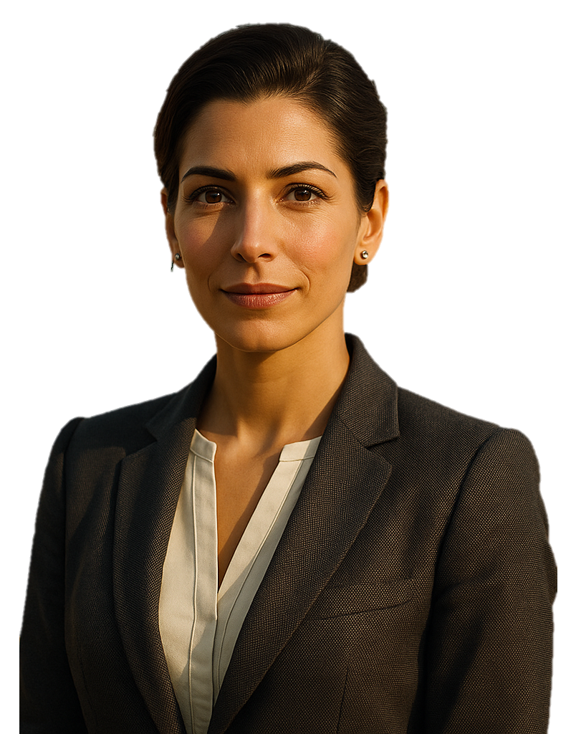
LOCAL – DIRECT HIRE
Persona Snapshot
Name
Rania al-Tarhuniya
Nationality
Libyan
Role Type
Direct Hire (Local Libyan Employee)
Typical Role
Senior Administrator
Assignment Duration
Permanent – Hired directly by Client
Managed by
Client (recruited through Dawaam)
Operational Value Delivered by Dawaam
Sourcing of qualified local candidates
Candidate screening, interviews, and shortlist presentation
Coordination of job offer and onboarding
Covered under Dawaam’s recruitment guarantee

Slide 7
SERVICE COSTING & SCOPE – TAILORED BY CONTRACTOR TYPE
Service Category | Kwame (Short-Term) | Nabil (Long-Term) | Rania (Direct Hire) | Fathi (Local Contractor) | Notes / Pricing Model
Recruitment Fee | – | – | ✓ One month gross salary | – | Billed upon successful placement
Visa Processing | ✓ from $2,500 | ✓ from $2,500 | – | – | Varies by nationality
Residency Permit | – | ✓ from $3,500 | – | – | Includes Desert Pass & Registration
Payroll Admin | ✓ | ✓ | – | ✓ | Cost + % fee or fixed rate
Logistics (Flights, etc.) | ✓ at cost + 25% | ✓ at cost + 25% | – | Optional | Transport, hotel, etc.
Insurance Coverage | ✓ | ✓ | – | ✓ | Included under Dawaam policy
The pricing presented above is indicative and intended for planning purposes. Final costs may vary depending on the contractor’s nationality, documentation requirements, and specific logistical arrangements. Dawaam provides tailored quotations for each assignment, ensuring full transparency and compliance with local regulations. All fees are structured to reflect actual service scope, with flexibility to align with the Clients’ operational needs and project conditions.

Slide 8
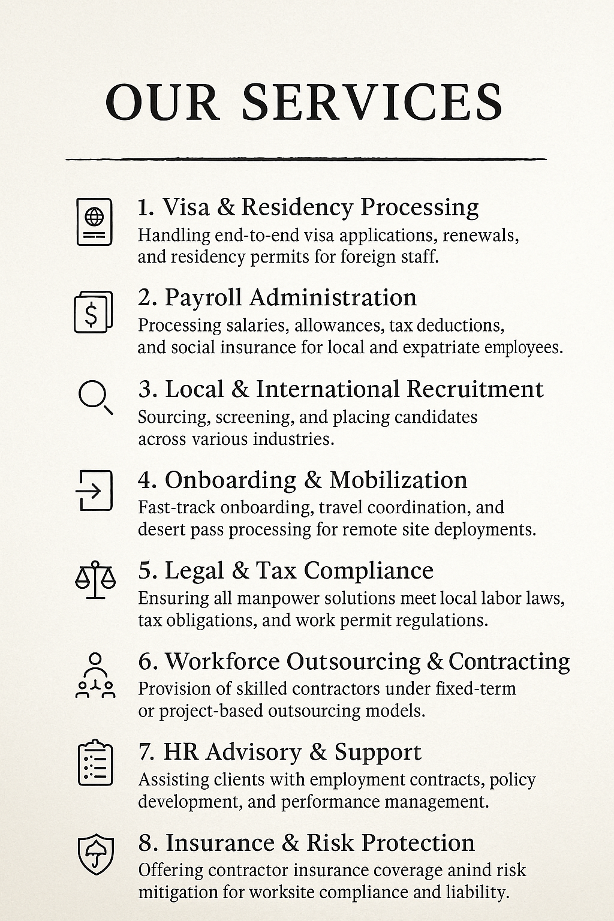


LET’S BUILD A COMPLIANT, SCALABLE WORKFORCE TOGETHER
At Dawaam, we don’t just place people — we deliver full-service workforce solutions tailored to Libya’s complex energy environment.
From urgent short-term deployment to long-term strategic staffing, we ensure every step is legal, efficient, and low-risk for our partners.

Slide 9

Thank you

